Slide 1



E Commerce Report
View in Power BI
Last data refresh:
6/6/2026 12:42:12 PM UTC
Downloaded at:
6/6/2026 12:48:10 PM UTC

Slide 2
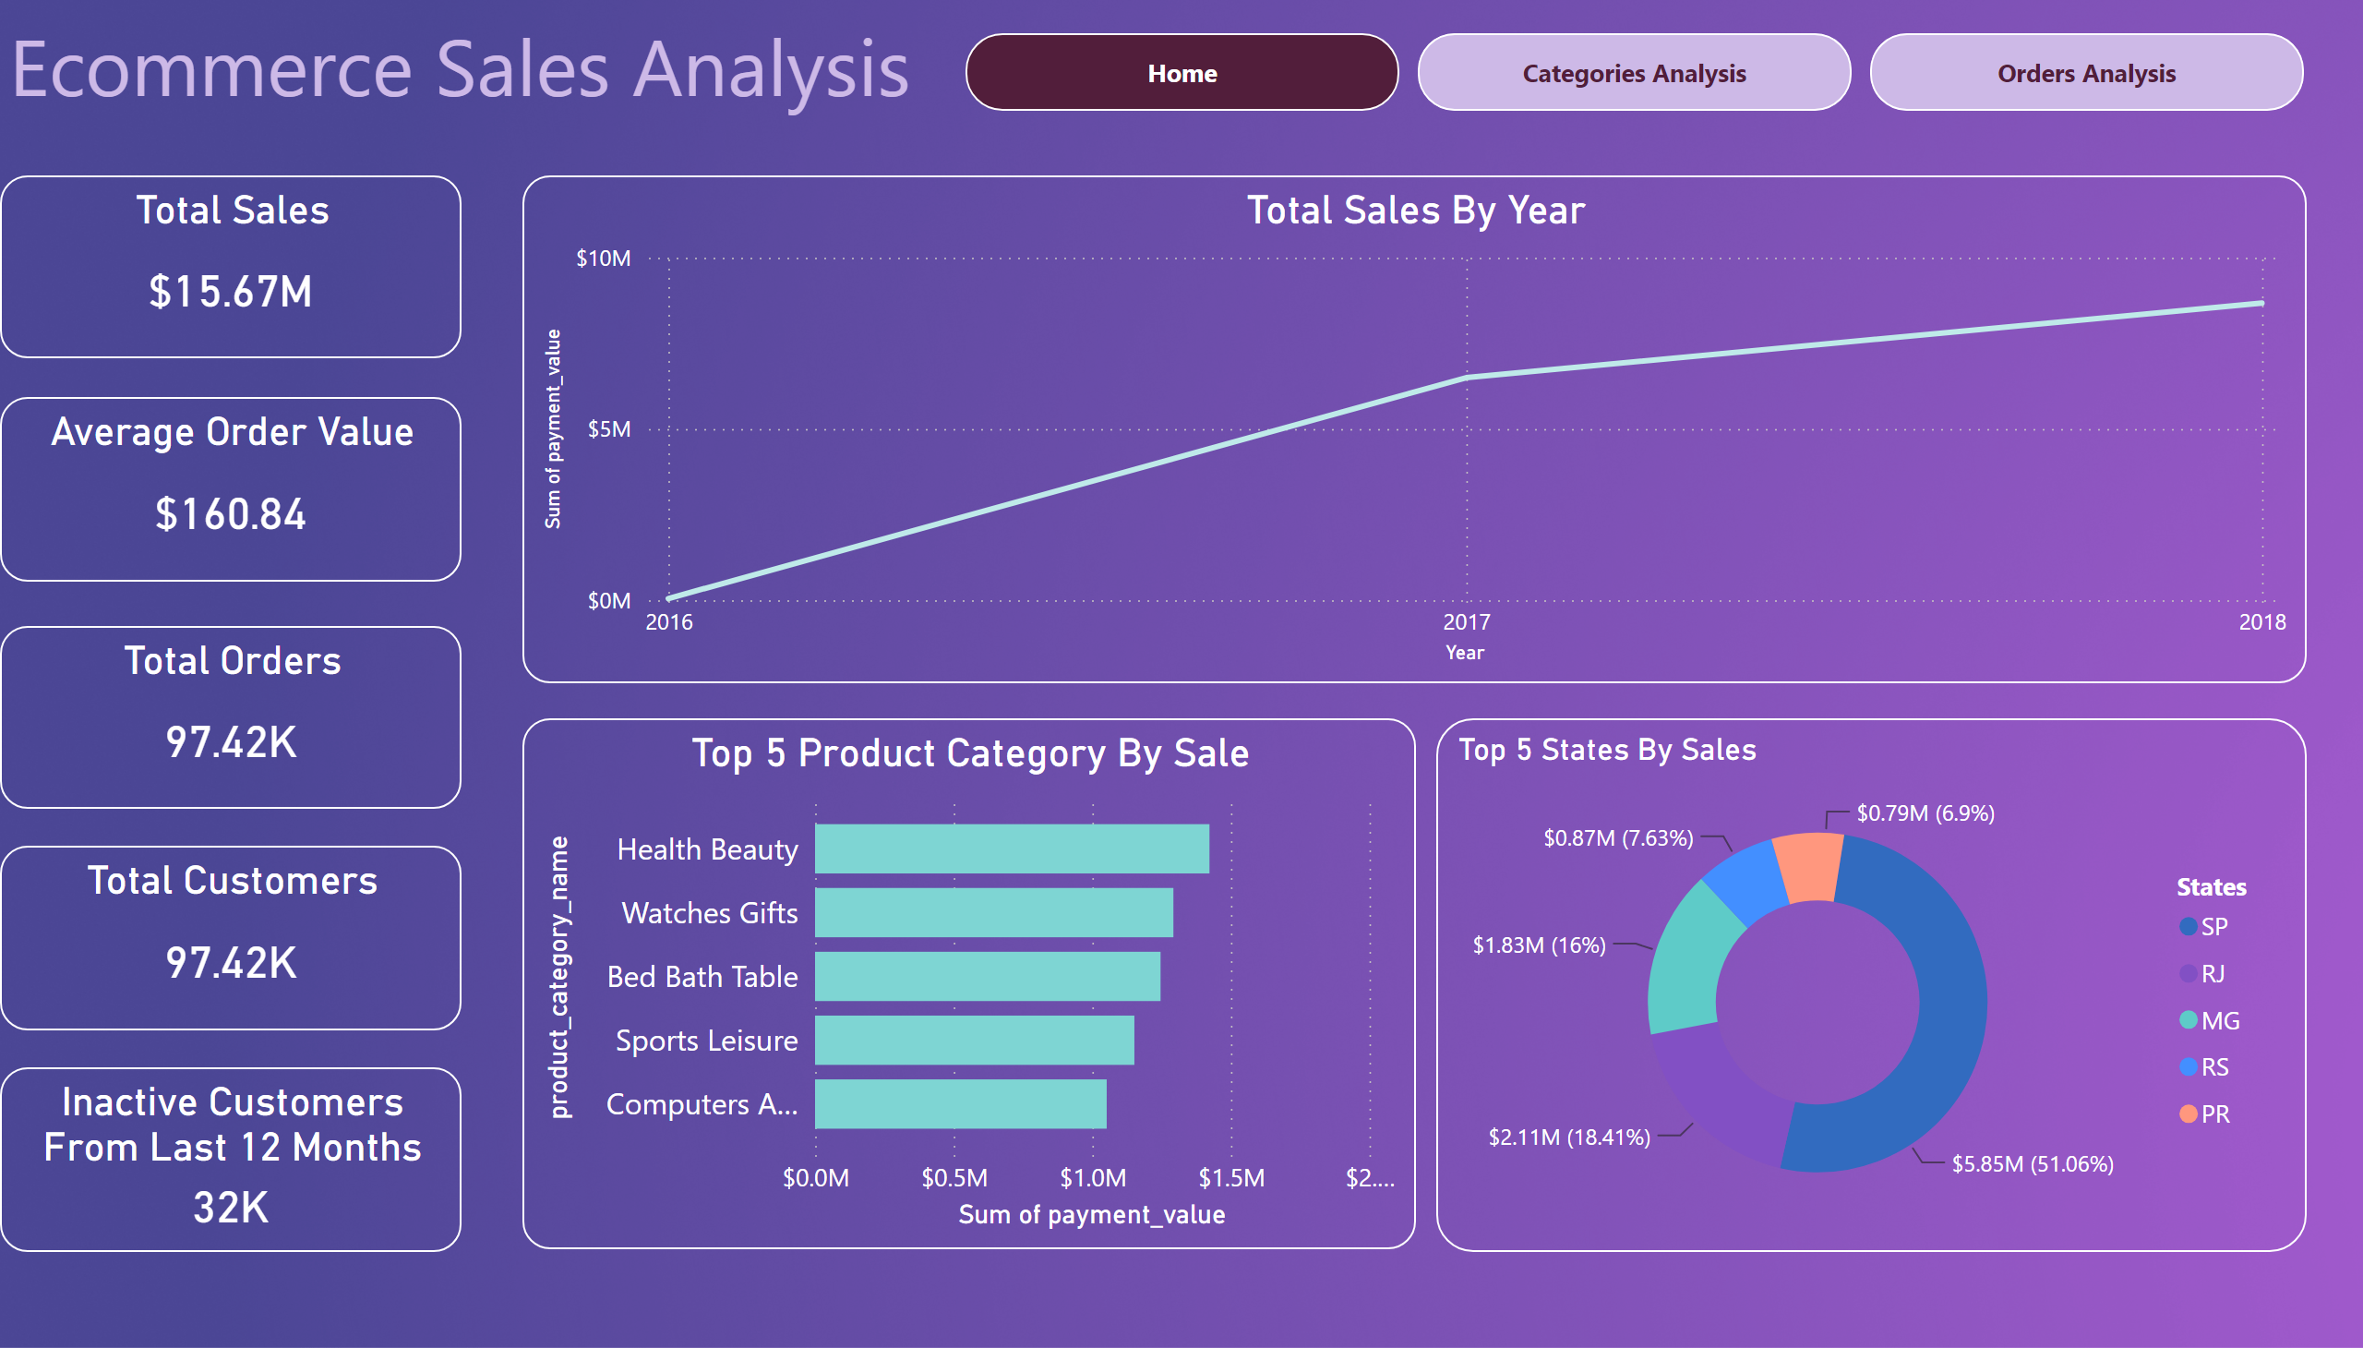
Home
Notes:
Total Customers
No alt text provided
Total Orders
No alt text provided
Total Sales
No alt text provided
Average Order Value
No alt text provided
textbox
No alt text provided
Total Sales By Year
No alt text provided
Top 5 Product Category By Sale
No alt text provided
Top 5 States By Sales
No alt text provided
pageNavigator
No alt text provided
Inactive Customers From Last 12 Months
No alt text provided

Slide 3
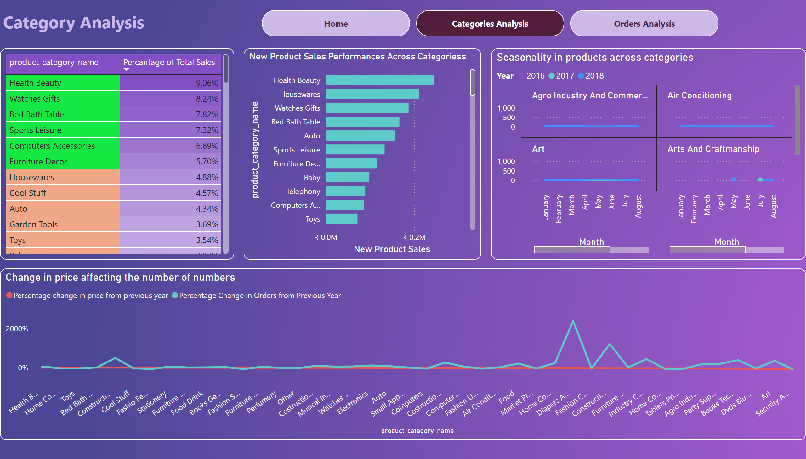
Categories Analysis
Notes:
New Product Sales Performances Across Categoriess
No alt text provided
tableEx
No alt text provided
Seasonality in products across categories
No alt text provided
textbox
No alt text provided
Change in price affecting the number of numbers
No alt text provided
pageNavigator
No alt text provided

Slide 4
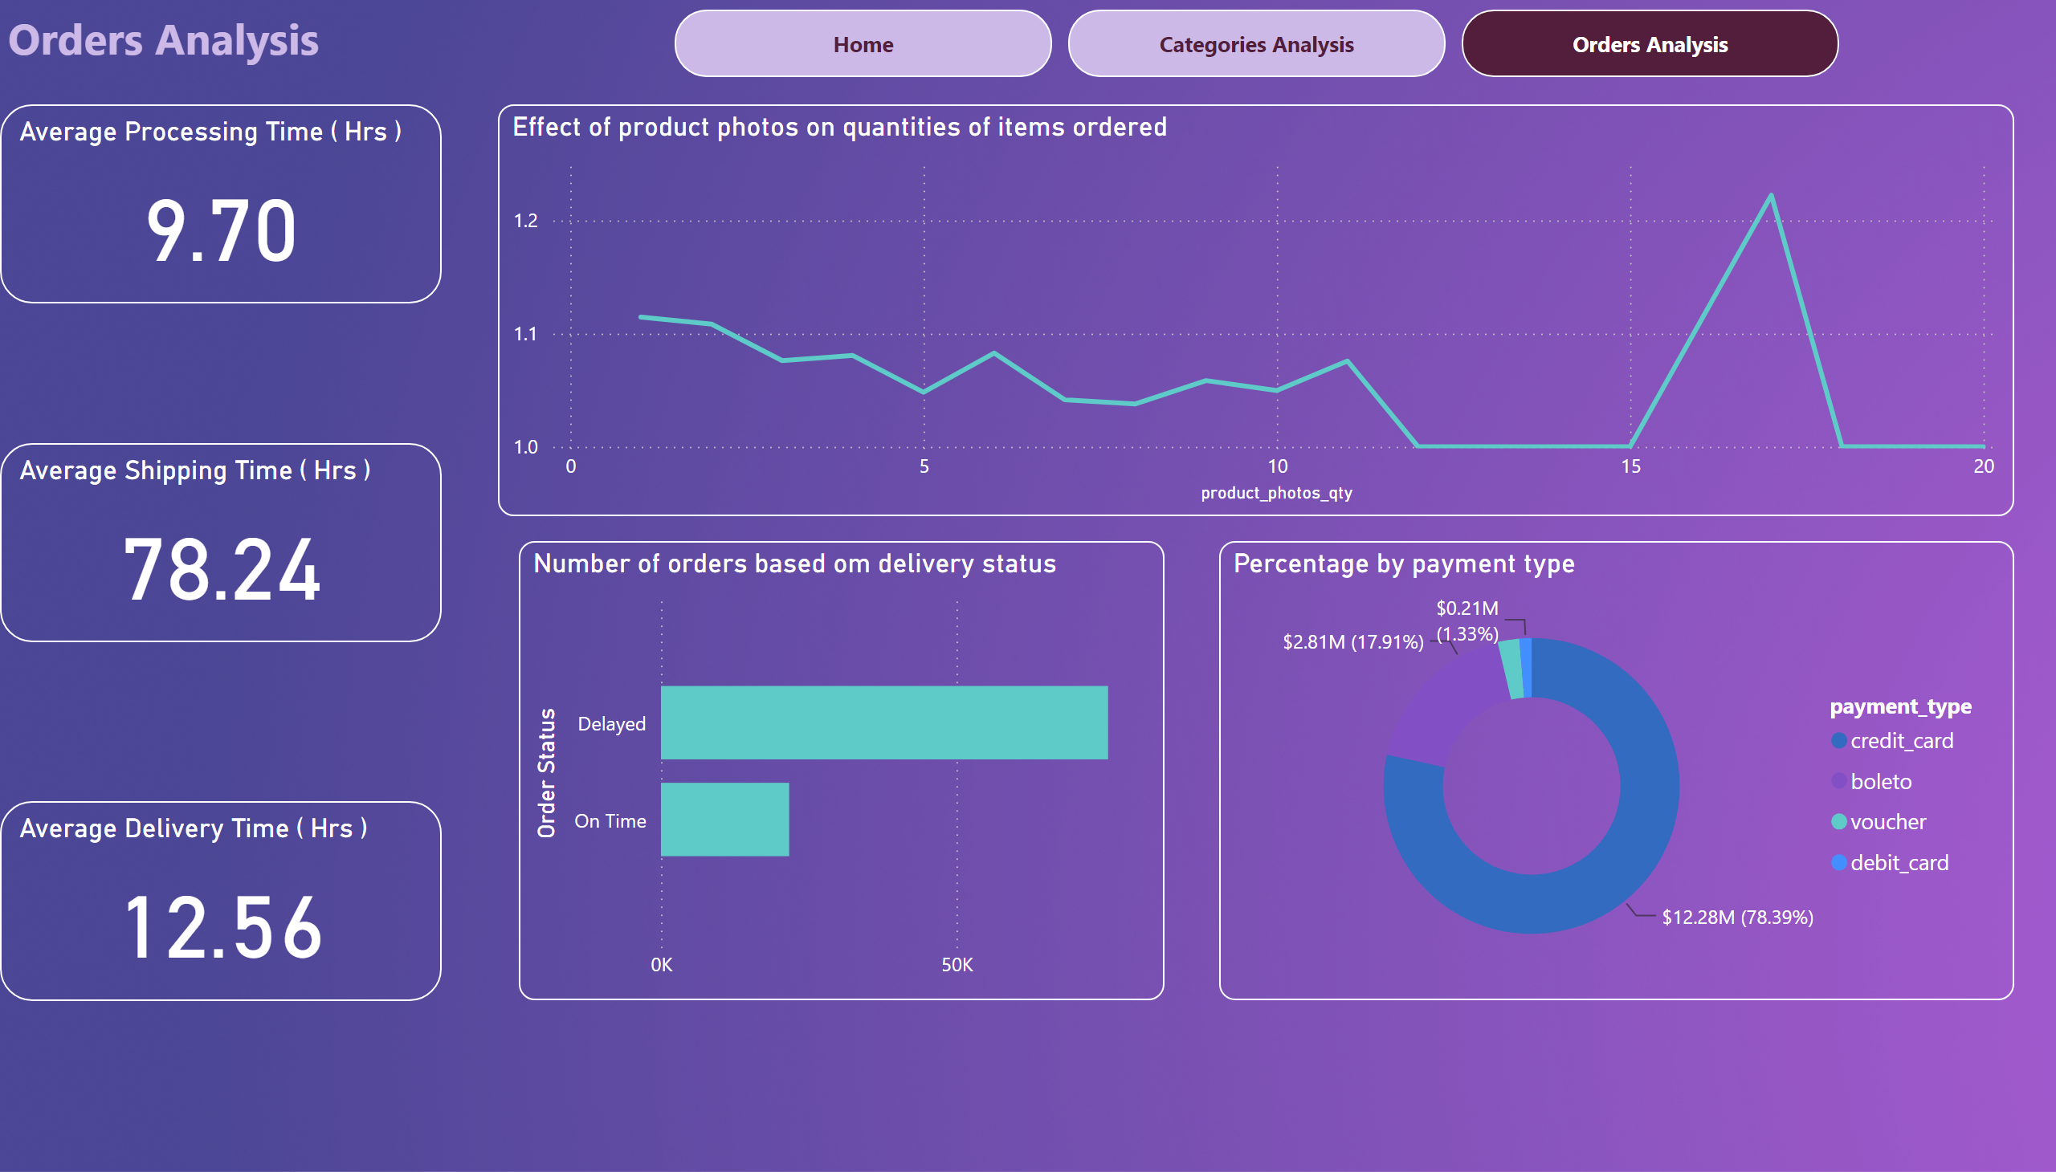
Orders Analysis
Notes:
Average Processing Time ( Hrs )
No alt text provided
Average Shipping Time ( Hrs )
No alt text provided
Average Delivery Time ( Hrs )
No alt text provided
Percentage by payment type
No alt text provided
Effect of product photos on quantities of items ordered
No alt text provided
Number of orders based om delivery status
No alt text provided
textbox
No alt text provided
pageNavigator
No alt text provided

